Slide 1
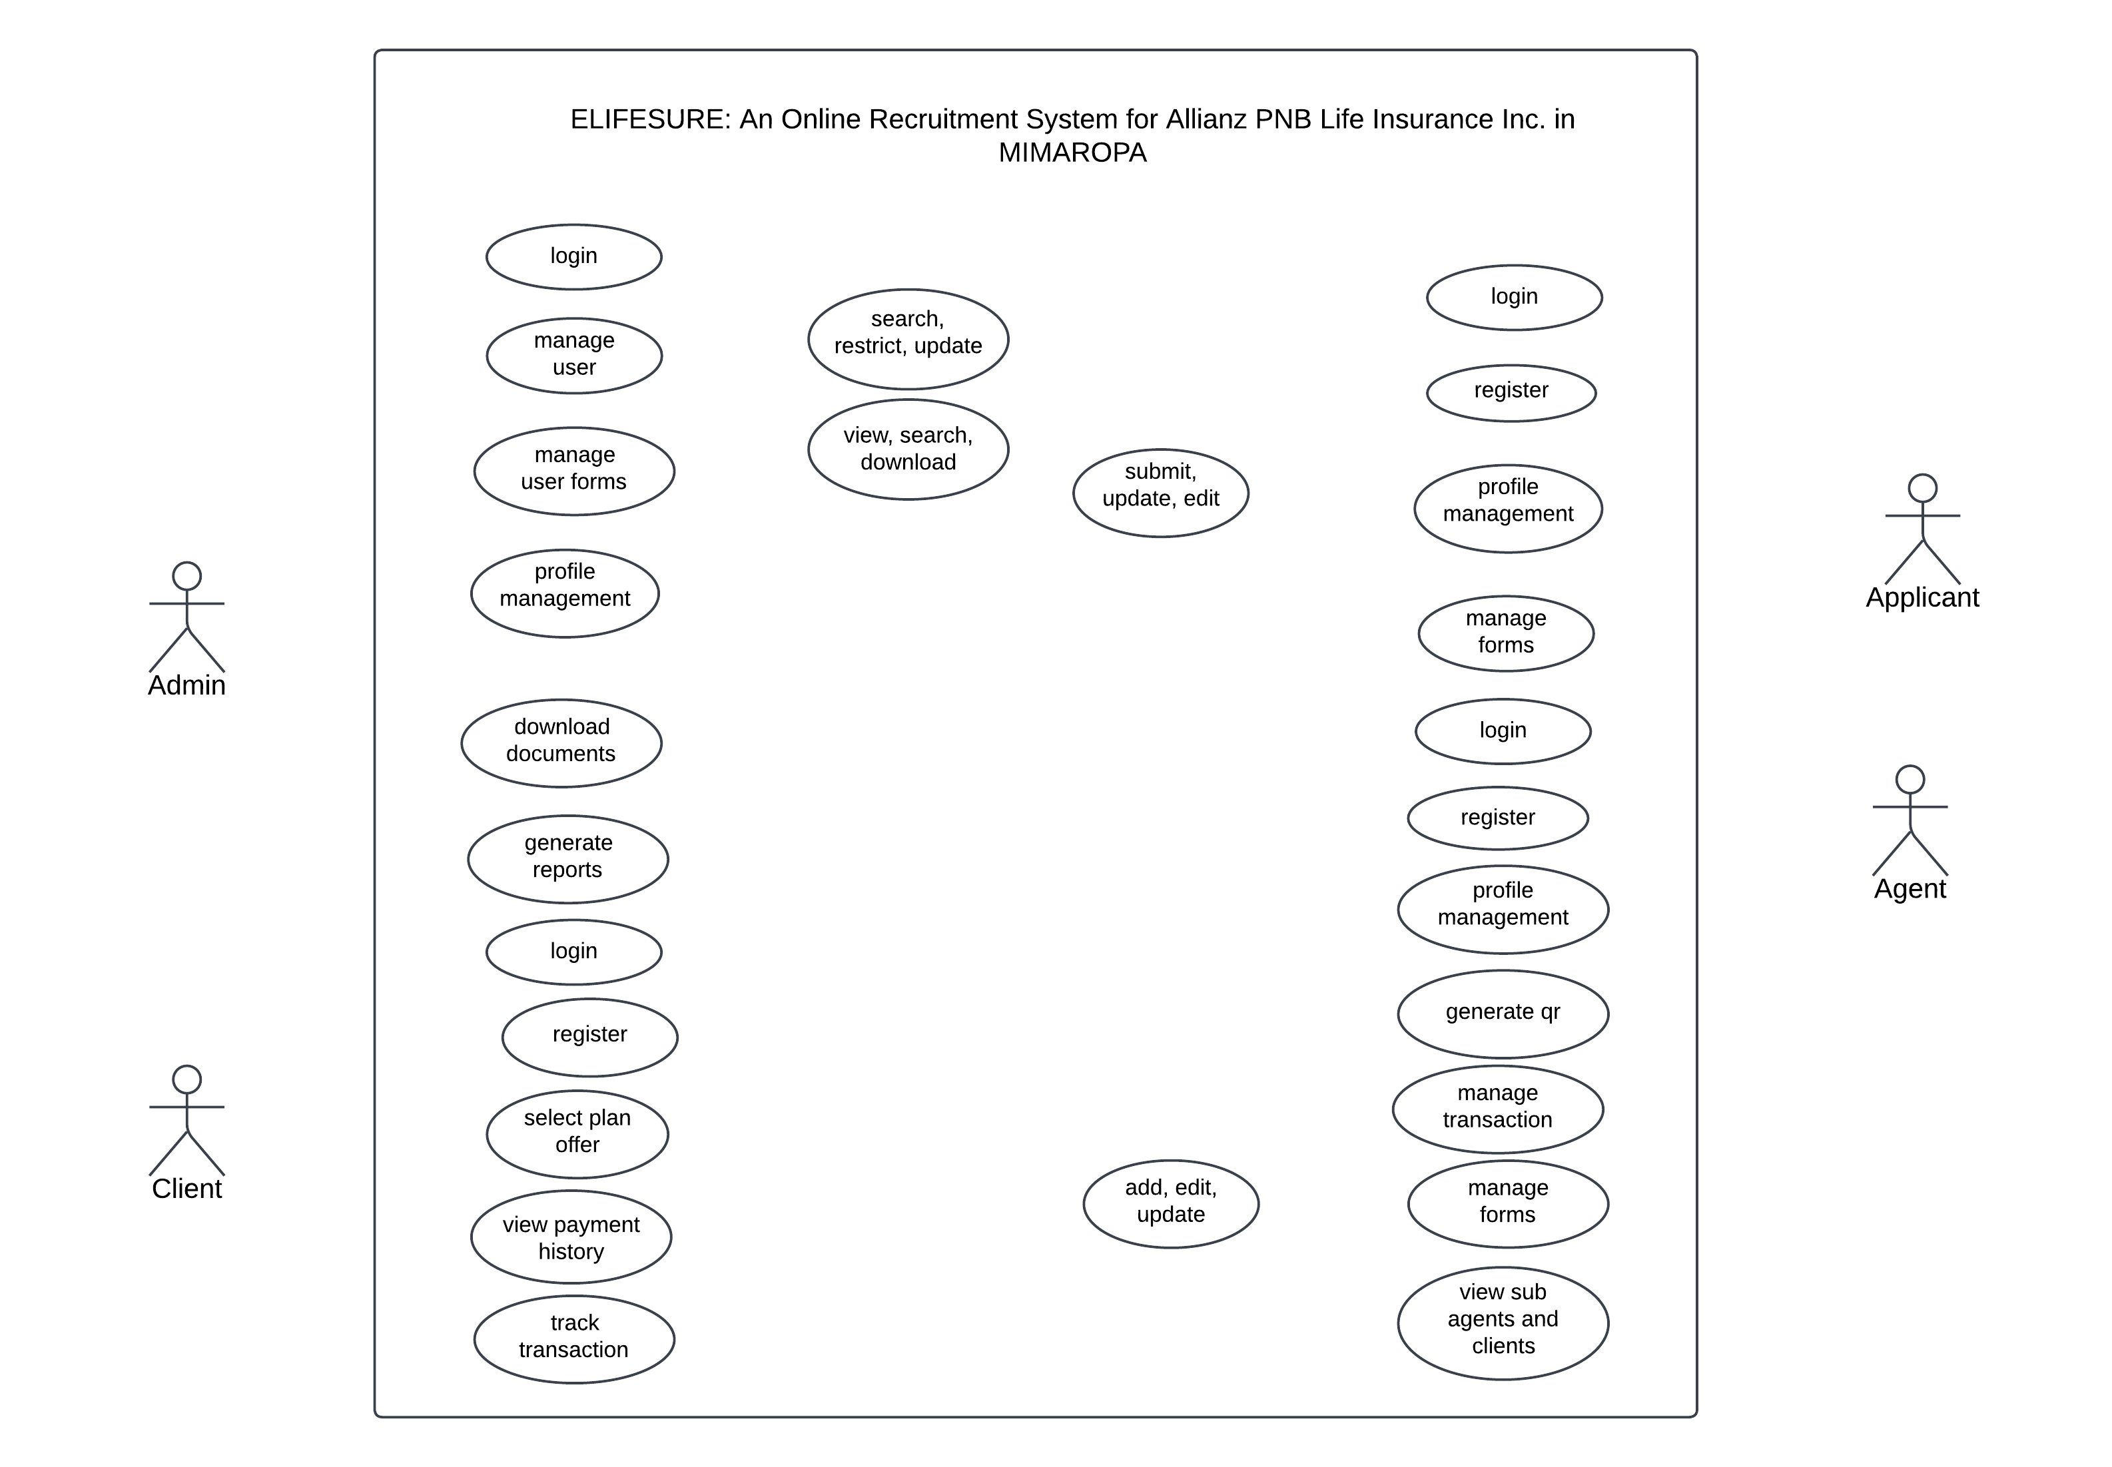
<< include >>
<< include >>
<< include >>
<< include >>
<< include >>
<< include >>

